Slide 1


AWS ReInforce Event
Generative AI is a powerful tool with the potential to revolutionize the way we work.

Slide 2
Schedule
AWS ReInforce: Generative AI & Security

Slide 3

Agenda
Build Secure AI Applications
1
2
Provide Insights Into Security & Automate Solutions
Provide Insights to Costs in a Multi-Account Environment
3

Slide 4
Build Secure AI Applications
AWS Bedrock
Amazon Q
Agents
Q Business
Knowledge Base
40 + Built- In Connectors
Guardrails:
Connect to Business Data
Block undesirable topics
Security and Privacy In-Mind
Filter harmful content
Guardrails
Redact sensitive information (PII) to protect privacy
Q Developer
IDE Integration
Block inappropriate content with a custom word filter
Diagnose errors
Develop software
Code Vulnerability Scan
Chat about code
Contact AWS Support
Notes:
Unite your disparate data silos Amazon Q Business offers over 40 built-in connectors to popular enterprise applications and document repositories, including Amazon Simple Storage Service (Amazon S3), Salesforce, Google Drive, Microsoft 365, ServiceNow, Gmail, Slack, Atlassian, and Zendesk. Bring your employees actionable insights in one unified experience. Get answers to questions across your business data Amazon Q Business quickly connects to your business data, information, and systems so that your employees can have tailored conversations, solve problems, generate content, and take actions relevant to your business. Amazon Q Business generates answers and insights according to the material and knowledge that you provide, backed up with references and citations to source documents. Built from the ground up with security and privacy in mind Amazon Q can understand and respect existing governance identities, roles, and permissions, personalizing interactions accordingly. If a user doesn't have permission to access certain data without Amazon Q, they cannot access it using Amazon Q either. Apply guardrails to customize and control responses Amazon Q Business provides administrative controls, such as the ability to block entire topics and filter both questions and finalized answers using keywords. This capability helps administrators ensure that Amazon Q Business responds in a way that is consistent with your company's guidelines. https://docs.aws.amazon.com/amazonq/latest/qdeveloper-ug/features.html https://aws.amazon.com/bedrock/guardrails/

Slide 5
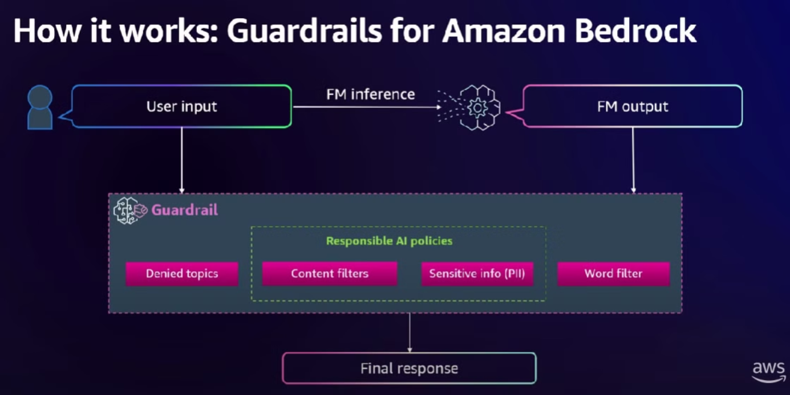
Bedrock Guardrails
https://www.youtube.com/watch?v=bvOPbUcSMg8

Slide 6
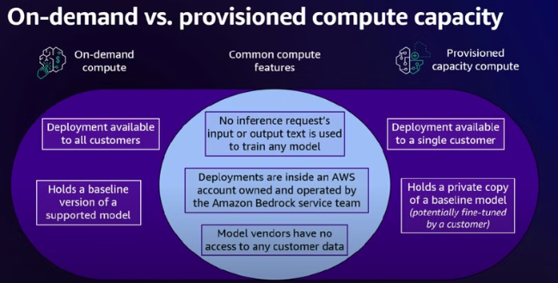
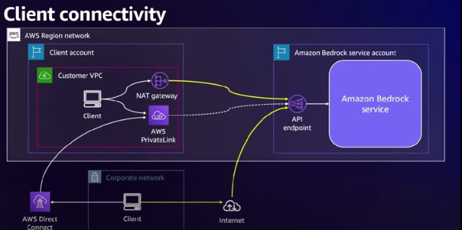
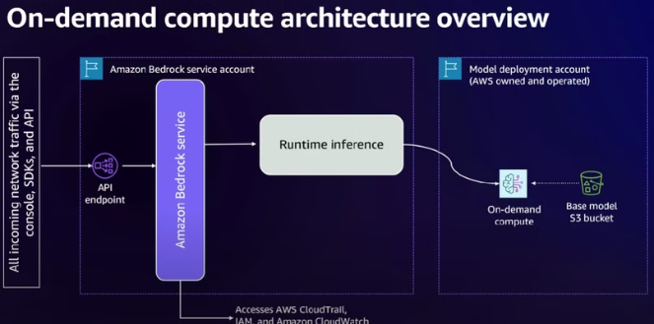
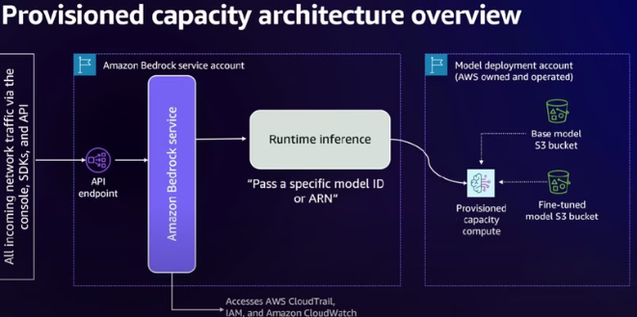
Bedrock Security Architecture
https://www.youtube.com/watch?v=bvOPbUcSMg8

Slide 7
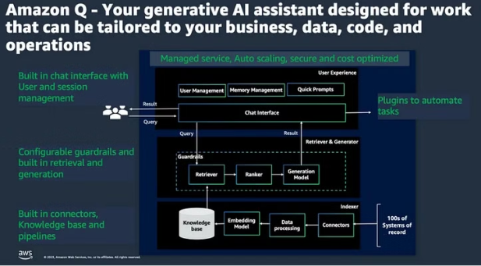
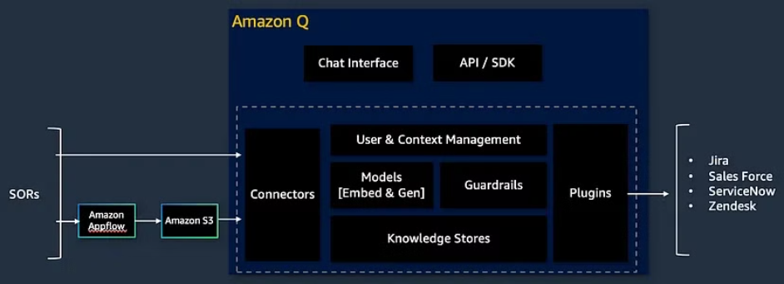
Amazon Q Business Architecture
Decoding Amazon Q for Business

Slide 8
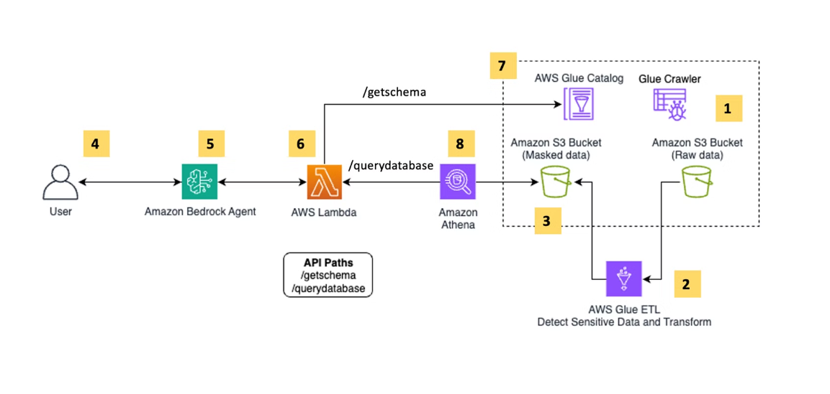
DAP271-R | Generative AI–driven data masking on AWS
Data Masking
Data Security
Protect sensitive data with AI-driven masking
Reduce risk of data leaks and unauthorized access.

Slide 9
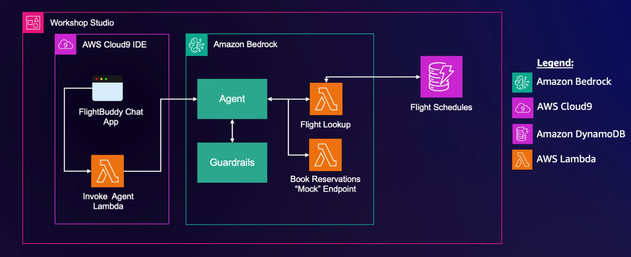
APS373-R1 | Build a more secure generative AI chatbot with security guardrails (Wednesday)
Secure generative AI app with the right guardrails against risks like prompt injection.

Slide 10
Provide Insights Into Security & Automate Solutions
Focus
Visualize
Resolve Findings
Use Generative AI to analyze security/vulnerability findings
Amazon QuickSight
Agent Tools:
Build interactive dashboards and data stories in minutes.
Bedrock Agents
Data Source:
Anthropic Tool Use(Function Calling)
Cloud Trail
Secure and share across your organization.
Security Hub
Amazon Inspector
Amazon Q
Amazon Bedrock
https://aws.amazon.com/quicksight/q/
Notes:
Reduce time to insights With the generative BI capabilities of Amazon Q in QuickSight, BI users can build, discover, and share actionable insights and narratives in seconds using intuitive natural language experiences. Analysts can quickly build visuals and calculations and refine visuals using natural language. Business users can self-serve data and insights using natural language. Users no longer have to wait for BI teams to update the data and dashboards for every new question. Users can self-serve with natural language querying, automated contextual summaries, and generated narratives. Security and privacy We built Amazon Q with security and privacy in mind. It can understand and respect your existing governance identities, roles, and permissions and use this information to personalize its interactions. If a user doesn't have permission to access certain data without Amazon Q, they can't access it using Amazon Q either. We have designed Amazon Q in QuickSight to meet the most stringent enterprise requirements from day one—none of your data or Amazon Q inputs and outputs are used to improve underlying models of Amazon Q for anyone but you. BI for everyone Amazon Q in QuickSight makes it straightforward for everyone to confidently understand data better. Business users can self-serve meaningful insights with ease. Even if they ask vague questions in natural language, they will receive comprehensive and contextual answers that completely explain the data using visuals and narratives. Business users can quickly generate visually pleasing, compelling narratives that are contextual, call attention to key insights, and make recommendations.

Slide 11
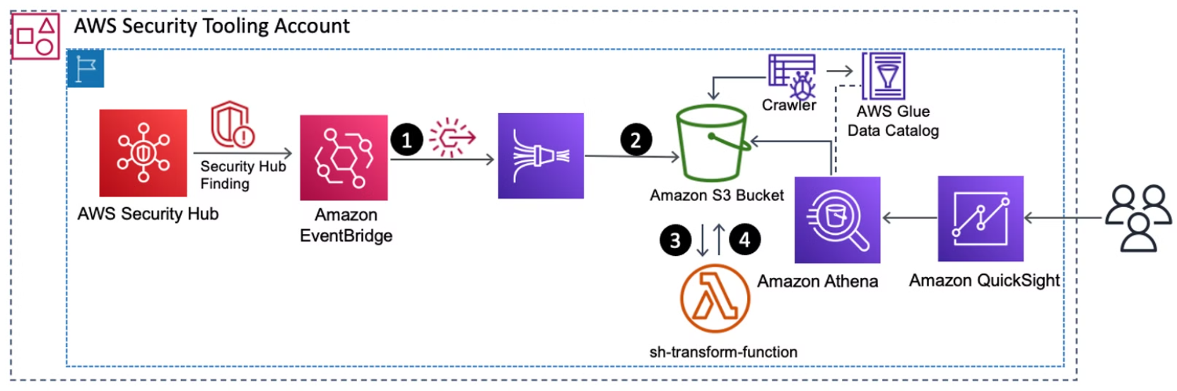
GRC352-R1 | Build a security posture leaderboard using generative AI
Build interactive dashboards and insights with AWS generative AI, security, and analytics services.
Notes:
combine AWS generative AI, security, and analytics services and leverage the power of generative AI to build dashboards and generate insights with NLP queries for various use cases and stakeholders.

Slide 12
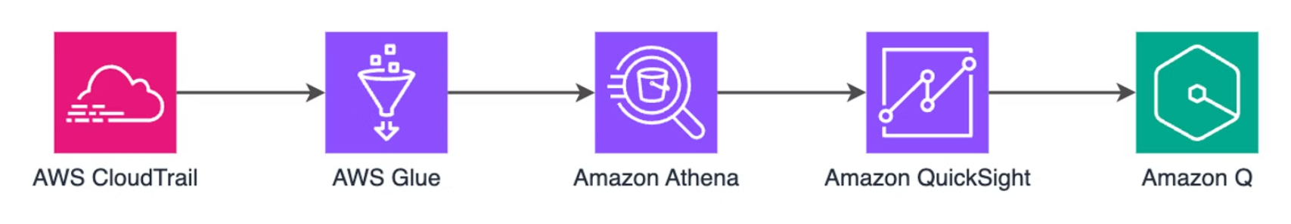
GRC251 | Gain insights into your AWS environment using AWS CloudTrail
Analyze CloudTrail data using CloudTrail Lake and Amazon QuickSight. Explore natural language querying and visualization.
Notes:
Analyze CloudTrail data using CloudTrail Lake and its built-in SQL query interface, and explore how to query CloudTrail data using natural language and visualize results using Amazon QuickSight and Amazon Q.

Slide 13
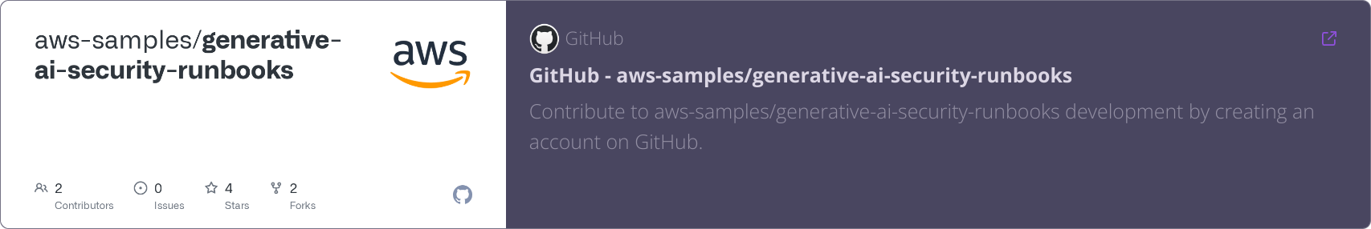
TDR451-R1 | Create a generative AI runbook to resolve security findings
In Module 1 - use Claude 3 from Anthropic to summarize a security findings, provide next steps for remediation, and create code to resolve the finding.
In Module 2 - tool use (also referred to as function calling), an advanced technique to expand Claude 3's capabilities to get real time data.

Slide 14

Provide Insights to Costs in a Multi-Account Environment
AWS Data Exports with QuickSight and Q
Create export of billing and cost data
Visualize your AWS costs using Amazon Quick Sight dashboards & Q
Notes:
AWS Data Exports enables you to create exports of your billing and cost management data using basic SQL delivered to your designated S3 bucket on a recurring basis for use with your business intelligence or third-party reporting solutions. AWS Data Exports also enables you to visualize your billing and cost management data by integrating with Amazon QuickSight, and deploying a pre-built Cost and Usage Dashboard within minutes.

Slide 15
Generative AI Use Cases for Fannie Mae
1
Secure Foundation
2
SRE AI Assistant
3
Onboarding Chatbot
Create stories and features, analyze architecture diagrams, formulate SLOs and SLAs, generate runbooks and DR strategies, and formulate alert configurations
Establish guardrails for any large language model (LLM) based applications
Assist new employees and contractors with onboarding
4
Business Intelligence
5
Infrastructure Team
Enhance insights with Amazon QuickSight and Amazon Q
Leverage Amazon Q for infrastructure-related tasks

Slide 16
Expo (Fun)

